Slide 1
Business Intelligence Dashboard: Profitability, Growth & ESG Insights
A Power BI Project for Business Stakeholders
Raja Rajeshwari Agnimandala | June 2025

Slide 2
Project Objective
Design an interactive dashboard for business stakeholders
Provide actionable insights into:
- Financial performance
- Growth trends
- ESG compliance
Tool used: Power BI
Dataset: Company Financial + ESG data (2016–2025)

Slide 3
Dataset Overview
Source: Kaggle
Records: ~1000+ companies
Key columns:
Revenue, Profit Margin, Market Cap,Growth Rate
ESG Scores: Environmental, Social, Governance
Region, Industry, Carbon Emissions

Slide 4
Dashboard Structure
Two-Page Interactive Dashboard
Page 1: Executive Summary
Page 2: ESG & Emissions Insights
Features:
KPIs, Slicers (Year, Industry, Region, Company)
Charts (Line, Bar, Scatter)
Navigation buttons between pages

Slide 5
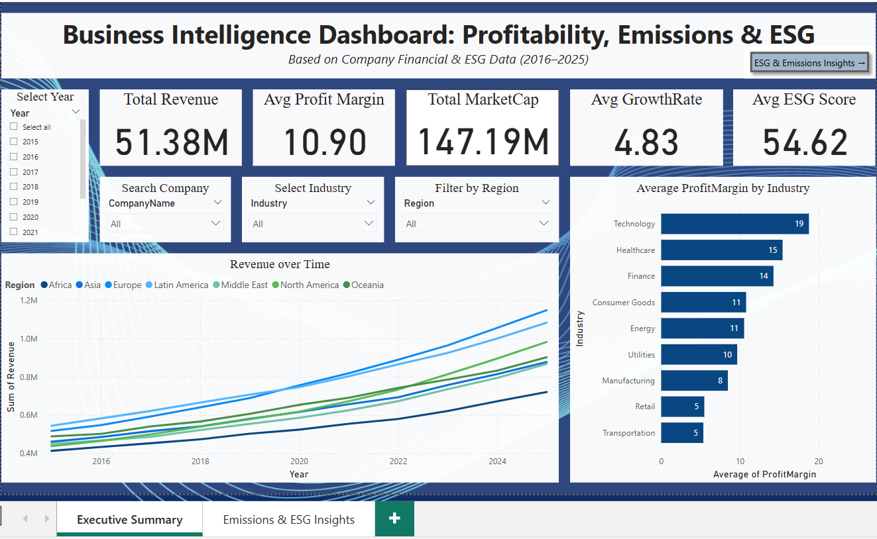
Executive Summary

Slide 6
Key Insights – Executive Summary
Total Revenue: $51.38M, Market Cap: $147.19M
Avg Profit Margin: 10.9% (led by Technology sector)
Revenue trend is consistently rising (2016–2025)
Asia & Europe show highest revenue growth
Slicers enable detailed company-level exploration

Slide 7
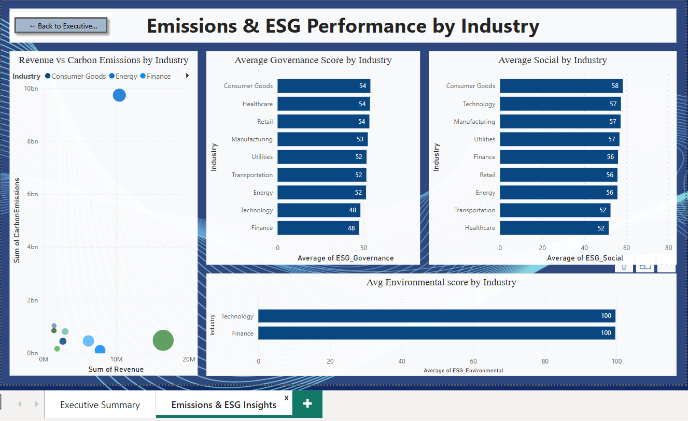
ESG & Emissions Insights

Slide 8
Key Insights – ESG Page
ESG Scores vary by industry:
Environmental: Technology & Finance = 100
Governance: Consumer-focused sectors = strongest
Energy sector: Highest carbon emissions, not the highest revenue
Social scores highest in Consumer Goods & Tech

Slide 9
Stakeholder Value
Data-driven decisions for investment, compliance, and strategy
Helps align financial goals with sustainability
Filters + Navigation improve usability
Clearly identifies high-performing industries over time

Slide 10
Thank You!
Thank you for reviewing this project.

